Slide 1





Machine Learning with Python

Slide 2
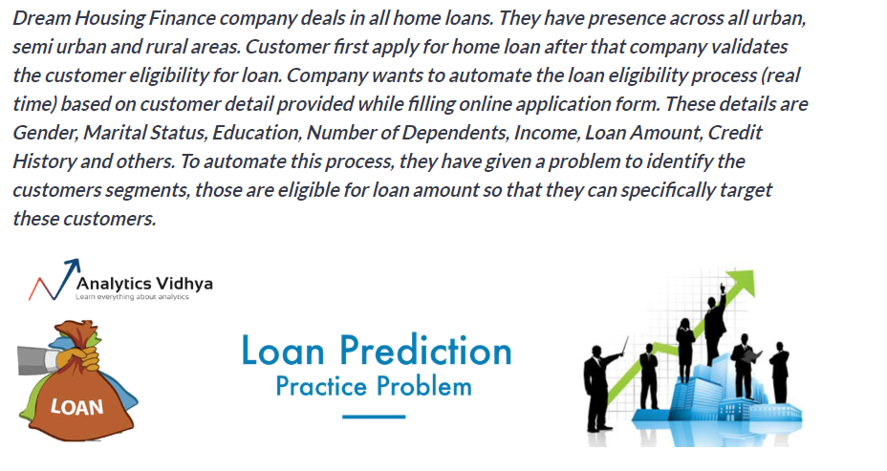
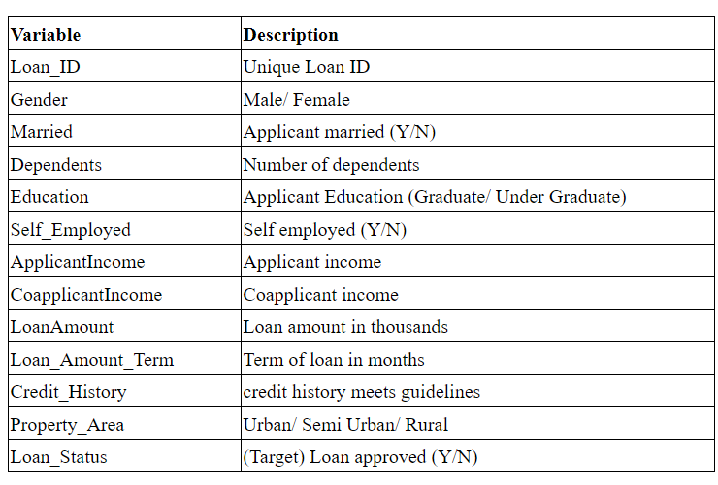



Loan Project Description

